Slide 1

Codar institute
Mojereola Racheal Opeyemi

Slide 2

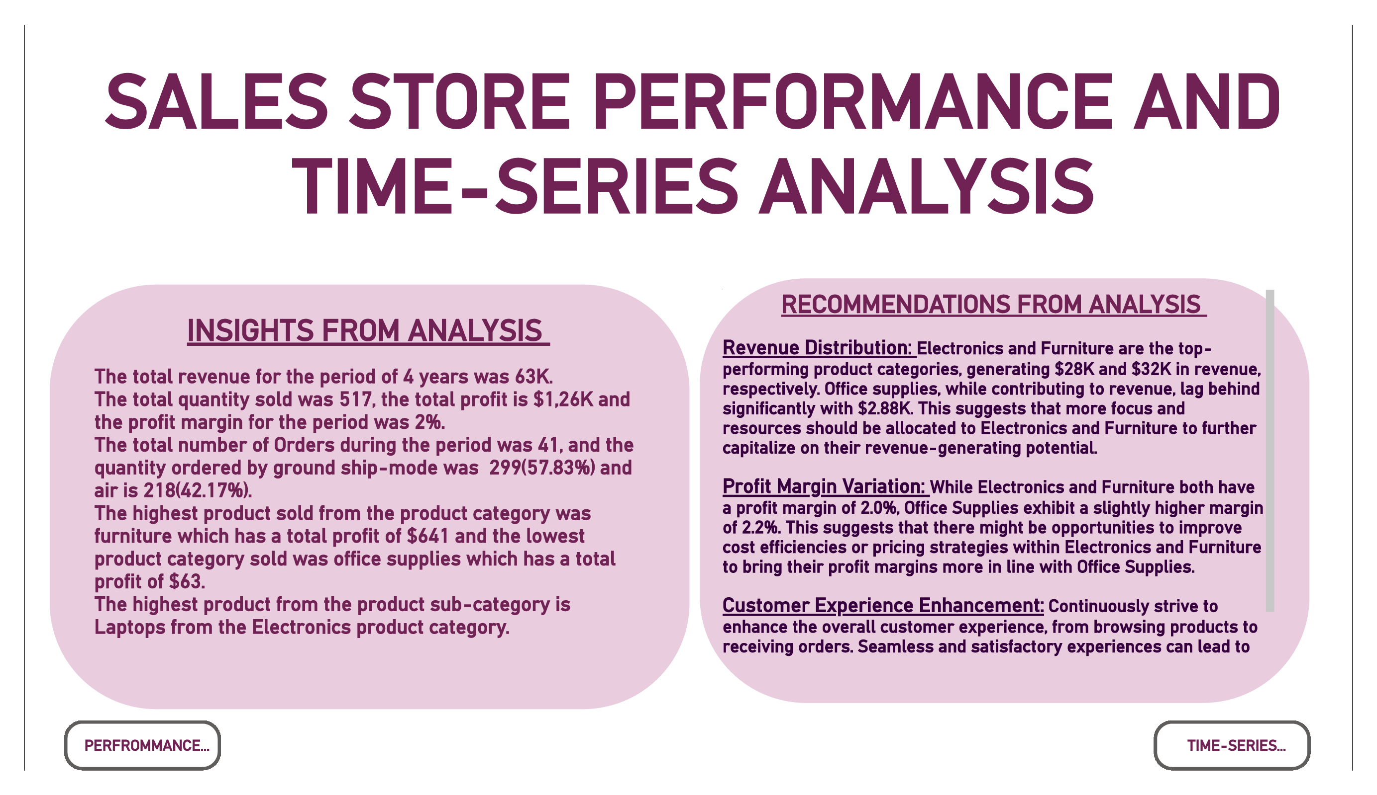
Tech Requirements
Network
Satellite
Link

Slide 3
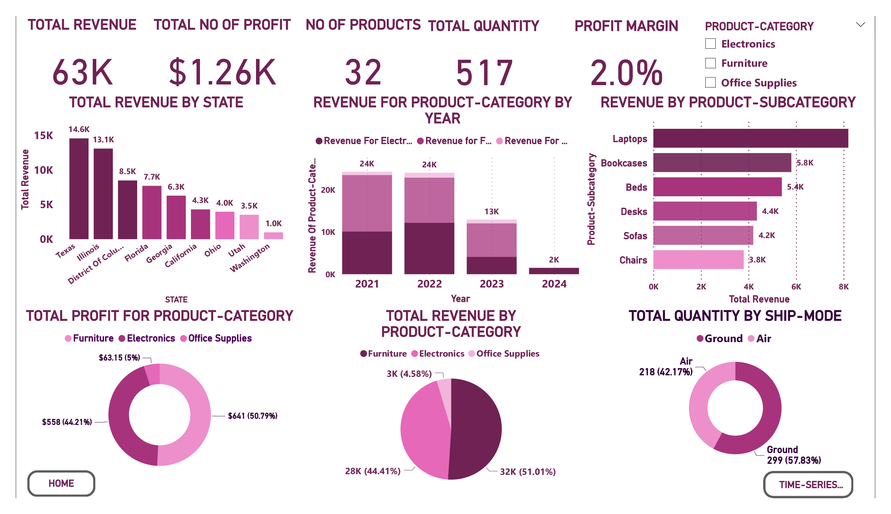

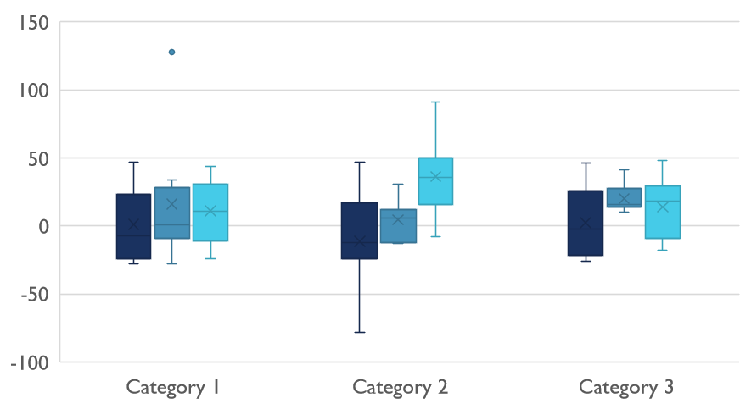
Competitive Landscape

Slide 4
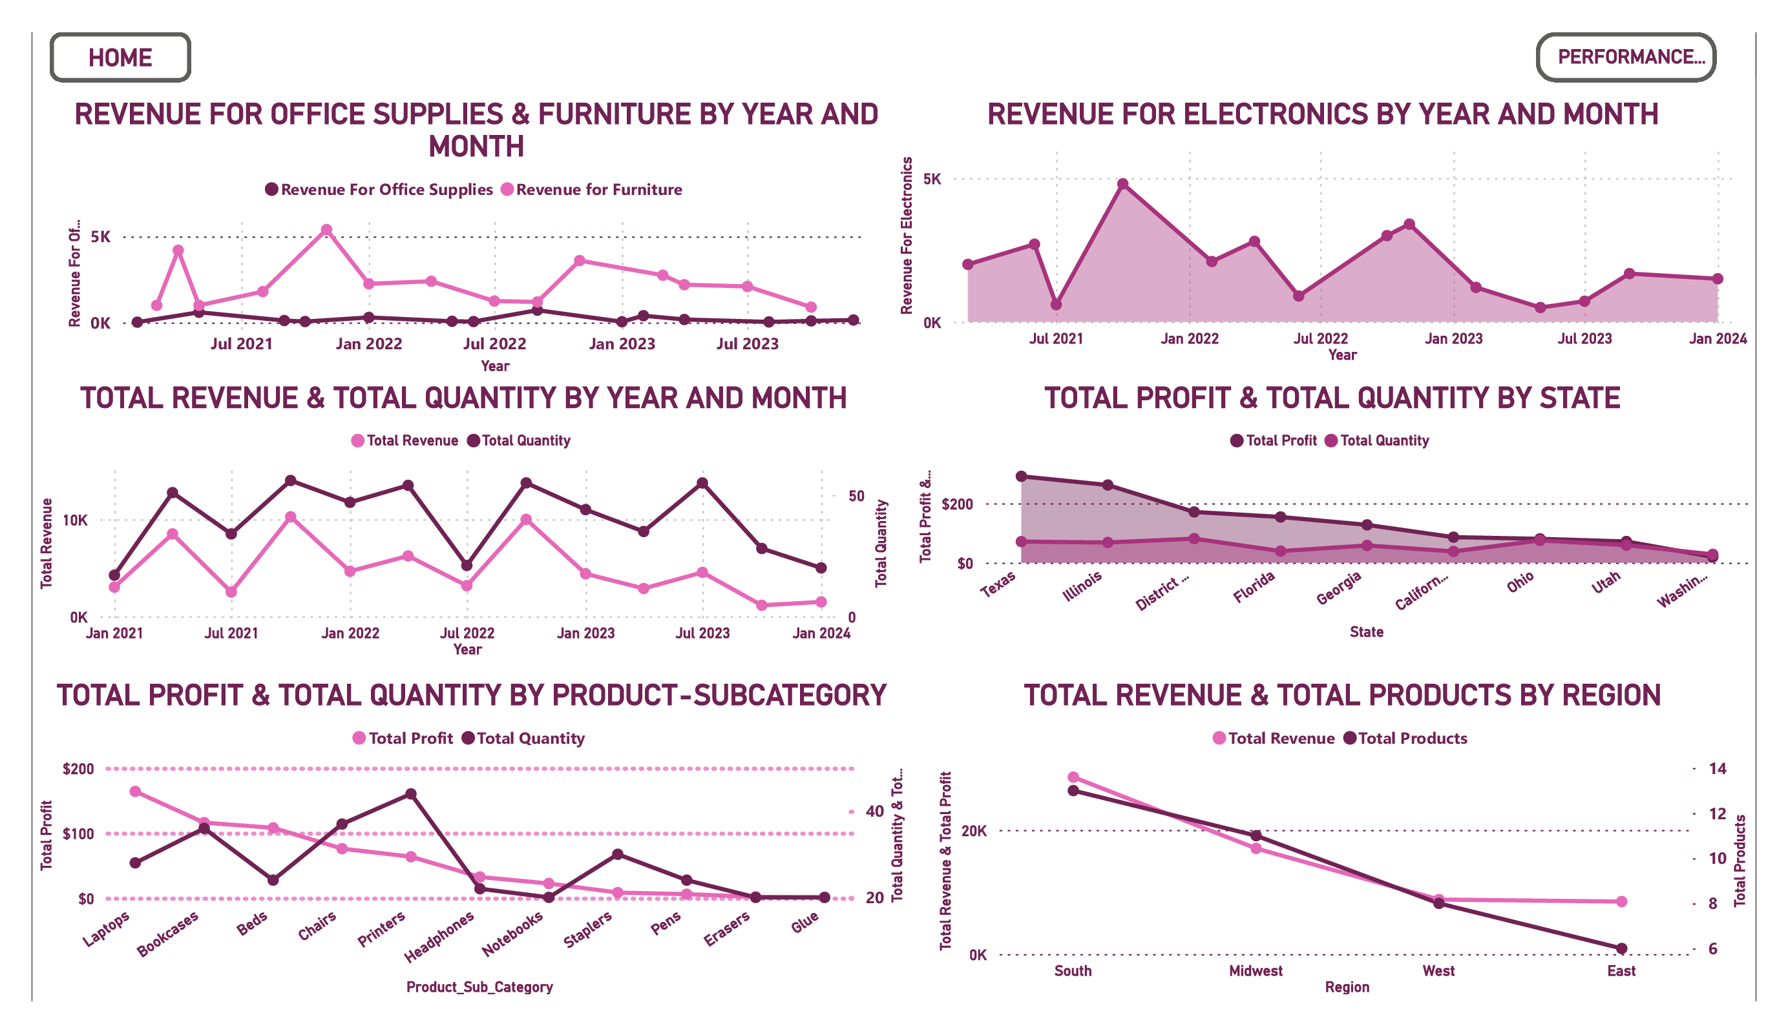

Digital Communications
Cloud
Local
Hybrid

Slide 5

Thank you

